Slide 1
Hydrogen Production from Renewable Energy
Group No.7
CH16B014 NAVALU RAHMAN
CH16B102 ANKIT KUMAR
CH16B112 NAZARE SHRIKRISHNA C.

Slide 2
Need for a cleaner fuel
Today, impending depletion of fossil fuel resources has become a main challenge of humankind.
To establish an environmentally friendly energy for the future of the world, we should develop carbon-neutral energy systems.
It was projected that to supply the energy demand of the world and support economic development, and maintain atmospheric carbon dioxide (CO2) levels at an acceptable level, approximately 10 TW (terawatt) of carbon-neutral power should be generated by the mid-century.
Hydrogen is one of the most promising alternative energy carriers, which does not exist freely in nature.
Same as electricity, hydrogen is not a source of energy and it is assumed as a secondary form of energy and will play a great role in the future scenario of energy sectors.

Slide 3
Why Hydrogen?
A clean fuel without toxic emissions.
Can be easily applied in fuel cells for electricity generation.
No CO2 emission, only product is water vapour.
High calorific value.
Hydrogen fuel cells are very efficient.
Reduced demand for foreign oil.
High Reliability.
Improved environmental quality.
Hydrogen as a fuel for automobiles poses some advantages such as rapid burning speed, no toxic emission and a high effective octane number.

Slide 4
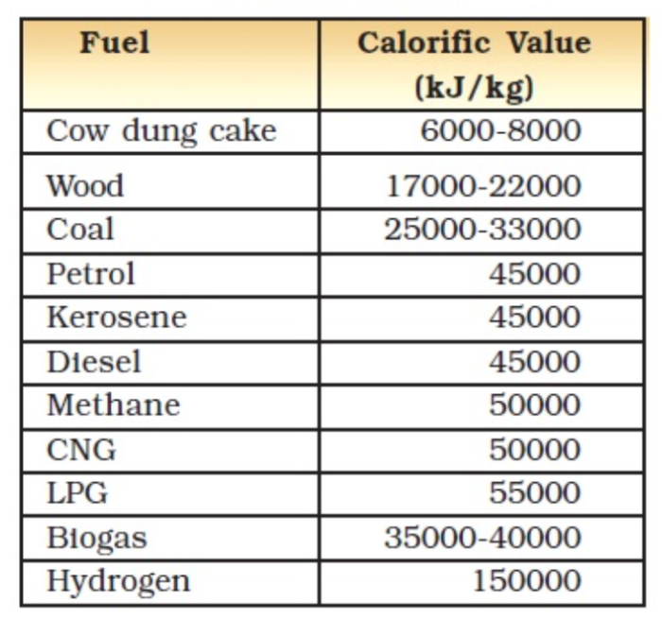
Comparison with other fuels
Energy yield of hydrogen is almost 3 times greater than hydrocarbon fuels.
The efficiency of hydrogen fuel cell (HFC) vehicles is three times more than gasoline engines.
Being a gas at normal pressures and temperatures, hydrogen presents greater storage and transportation barriers than exist for the liquid fuels.

Slide 5
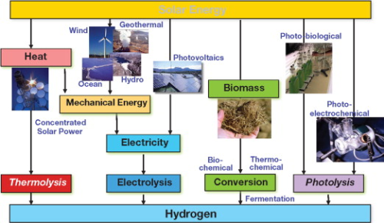
Ways of hydrogen production

Slide 6
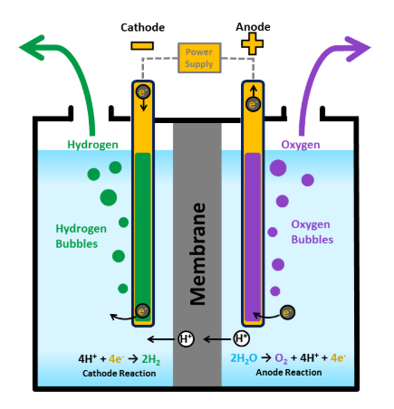
Electrolysis
Decomposition of water into oxygen and hydrogen gas due to the passage of an electric current.
This reaction takes place in a unit called an electrolyzer.
water electrolysis system operates at 70–75% energy efficiency
Ideal potential difference of water splitting is 1.23 volts.
Electrolysis is a promising option for hydrogen production from renewable resources.
POLYMER ELECTROLYTE MEMBRANE ELECTROLYZERS

Slide 7

Solar to Hydrogen System (SHS)
In SHS, the PV energy cracks H2O molecules into H2 and O2 which are applied later in Hydrogen Fuel Cells (HFC) to make electricity when the sun is not shining.
The infrastructure of first SHS was made in El Segundo, California in 1995. A complex of advanced PV cell and electrolyzer generated about 50–70 m3 hydrogen per day.
Efficiency of SHS is approximately 8–14% for commercial silicon-based solar cells.SHS has great potential to increase the efficiency up to 25–30%.

Slide 8
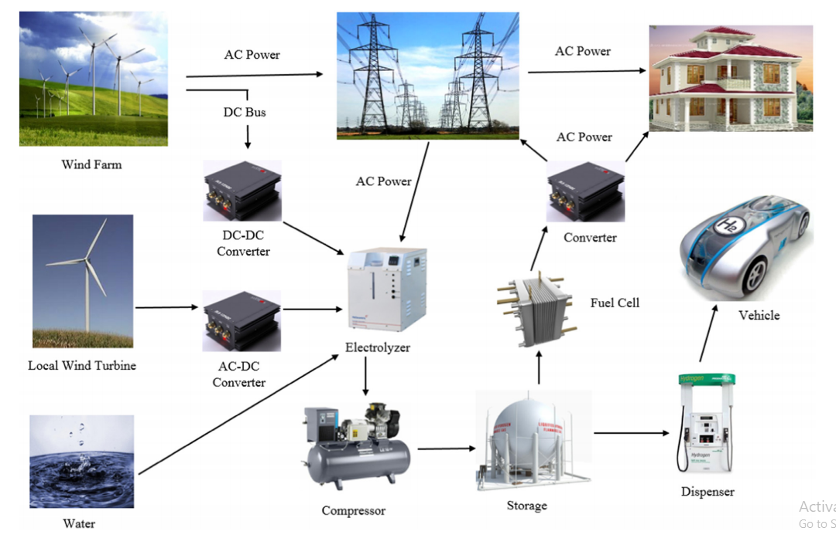
Integrated system of electricity/hydrogen generation from wind power.

Slide 9
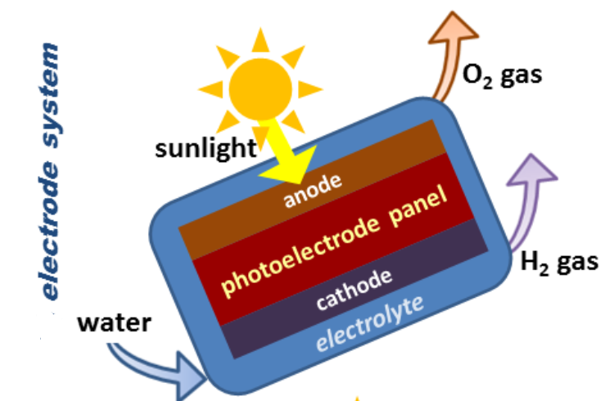
Hydrogen from photolysis
Direct solar water splitting, or photolytic, processes use light energy to split water into hydrogen and oxygen. 2 types are there -
Photoelectrochemical (PEC)
Use of semiconductor materials to convert solar energy directly to chemical energy in the form of hydrogen.
Semiconductor is immersed in a water-based electrolyte, where sunlight energizes the water-splitting process.

Slide 10
(2) Photobiological
Use of microorganisms such as green microalgae or cyanobacteria and sunlight to turn water, and sometimes organic matter, into hydrogen.
Hydrogen ions can be combined through direct or indirect routes and released as hydrogen gas
Algae and bacteria could be grown in water that cannot be used for drinking or for agriculture, and could potentially even use wastewater.
Low rates of hydrogen production, inhibition of hydrogen production reaction because of oxygen produced are some challenges faced.
Some photosynthetic microbes use sunlight to break down organic matter, releasing hydrogen called as photo-fermentative process.

Slide 11
Hydrogen from biomass
Wood, agricultural crops, the waste of agricultural byproducts, animal waste, municipal solid waste(MSW), waste from food processing, aquatic plants and algae are the most important sources of biomass.
Biomass restores degraded lands,increasing biodiversity, soil fertility and water retention.
Availability, diversity and the low prices of biomass feedstock, elimination of CO2 capture and storage(CCS) as well as sulfur removal system are the most promising characteristics of biomass based hydrogen production process.
Bioenergy contributes in mitigation of poverty in developing countries and supplies required energy at all times without complicated energy conversion instrument and expensive process.

Slide 12
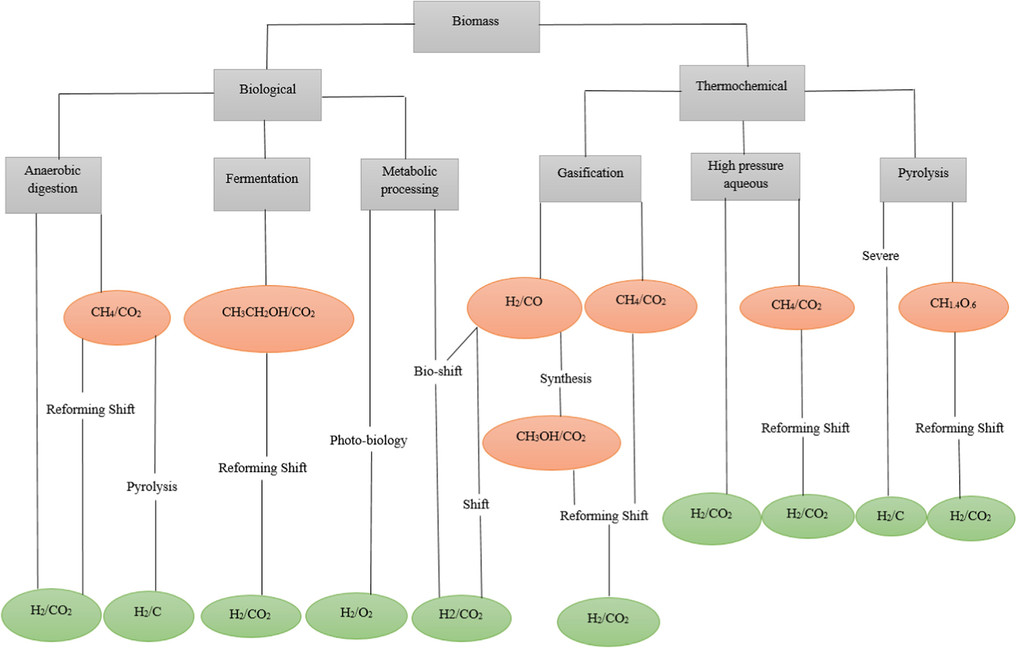

Slide 13
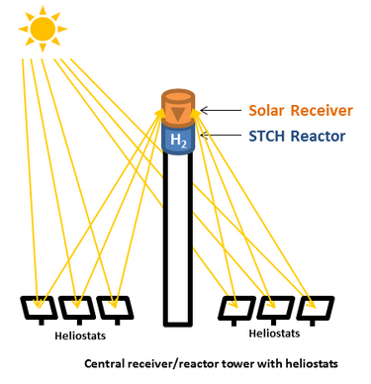
Hydrogen from thermolysis
Thermochemical water splitting uses high temperatures (500°–2,000°C) to produce hydrogen and oxygen from water —
(1) From concentrated solar power onto a reactor tower using a field of mirror "heliostats” or
(2) From the waste heat of nuclear power reactions—and chemical reactions.
The chemicals used in the process are reused within each cycle, creating a closed loop that consumes only water and produces hydrogen and oxygen.

Slide 14
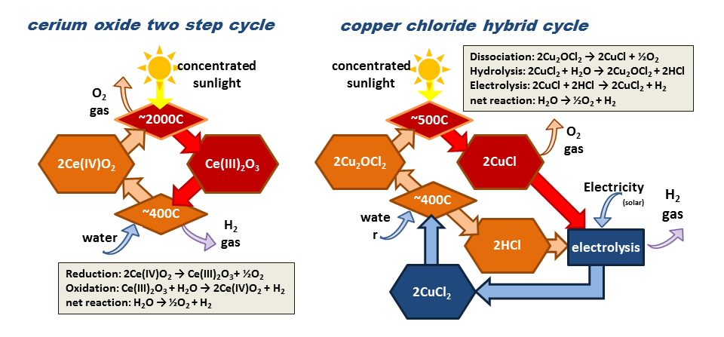
Two examples of thermochemical water splitting cycles, the "direct" two-step cerium oxide thermal cycle and the "hybrid" copper chloride cycle

Slide 15
Hydrogen production from geothermal energy
Geothermal could be an attractive option for hydrogen production due to its relatively low cost and high availability.
Geothermal energy is obtained in the form of heat or electricity,which can be applied to generate hydrogen by hybrid cycles or electrolysis.
More than 100 various thermochemical cycles have been proposed for hydrogen production.
Br–Ca–Fe cycle and sulphur–iodine(S–I) cycle as the most promising high-temperature cycles and copper–chloride (Cu–Cl) as the best lower-temperature cycle.
Hydrogen production from geothermal energy has been implemented in Hachijo Island in Japan as well as Iceland.

Slide 16
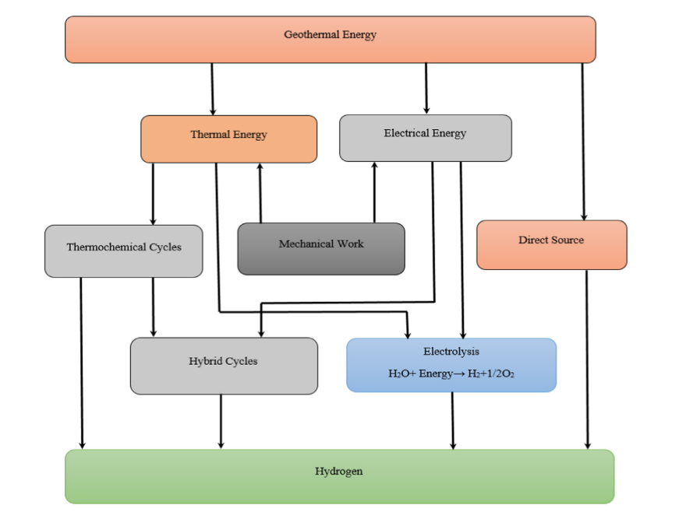
Pathway of geothermal-based hydrogen production process

Slide 17
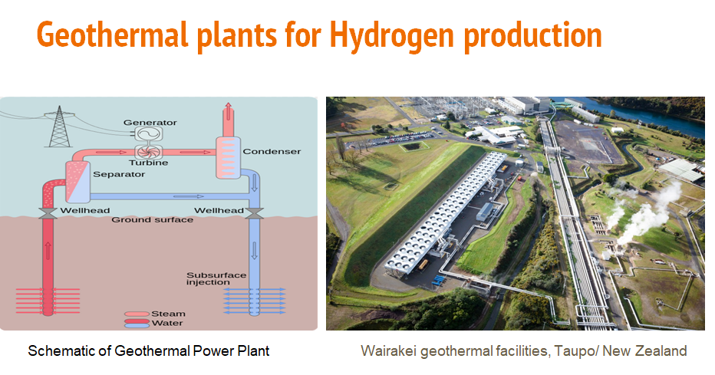

Slide 18
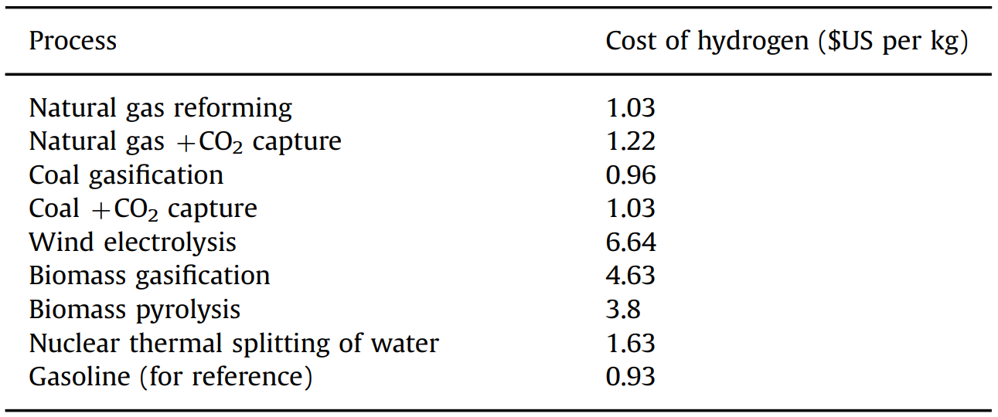
Production cost comparison

Slide 19
Drawbacks of Hydrogen fuel
Being a gas at normal pressures and temperatures, hydrogen presents greater storage and transportation barriers than those exist for the liquid fuels.
The unavailability in nature and the expensive production process of hydrogen are the other hurdles that make hydrogen gas an uneconomic fuel.
Moreover,the small size of hydrogen molecules causes hydrogen to be leaked from the vessel.
If significant amounts of Hydrogen escape to the environment, free radicals of hydrogen can be constituted due to ultraviolet radiation,which leads to ozone depletion.

Slide 20
Conclusion
The future energy scenario of the world as well as global warming phenomena lead the energy mix of the world to the renewable energy resources.In this regard, hydrogen has been introduced as a promising energy carrier for clean development.
Currently, hydrogen production from nonrenewable resources is dominant in the world.For each ton of hydrogen production from coal, approximately 5 tons of carbon in the form of CO2 is released.
In wind and solar power plants, hydrogen could be employed as an intermediate energy carrier.
Biomass conversion, photolysis and thermolysis are more appropriate methods based on sustainable energy sources, methods that do not employ electricity as an intermediate step.

